Slide 1
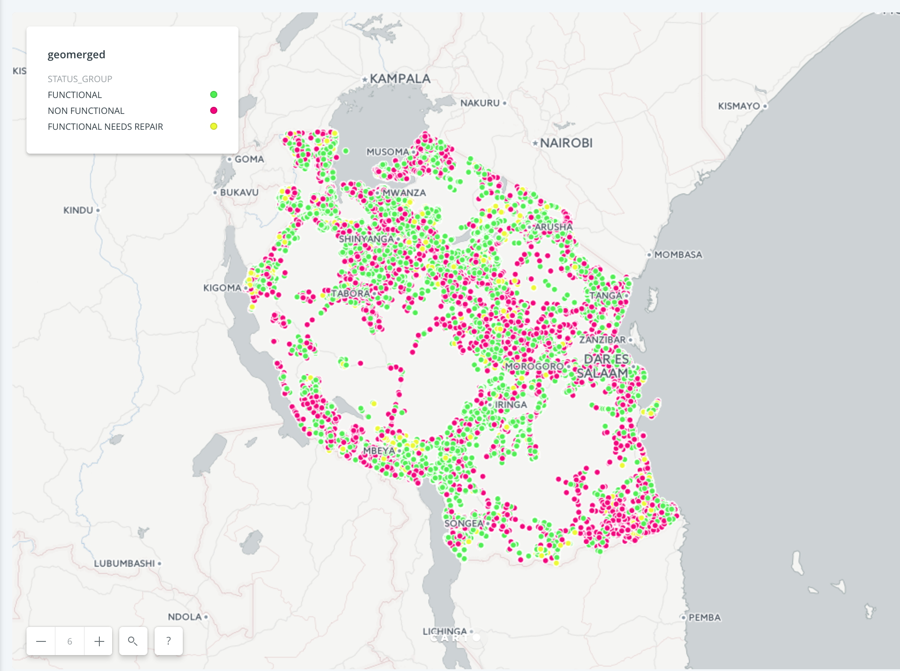
.Course: Data Circle Project: Water Pump.
Sprint: 1 Group: Hydro Dominion

Slide 2

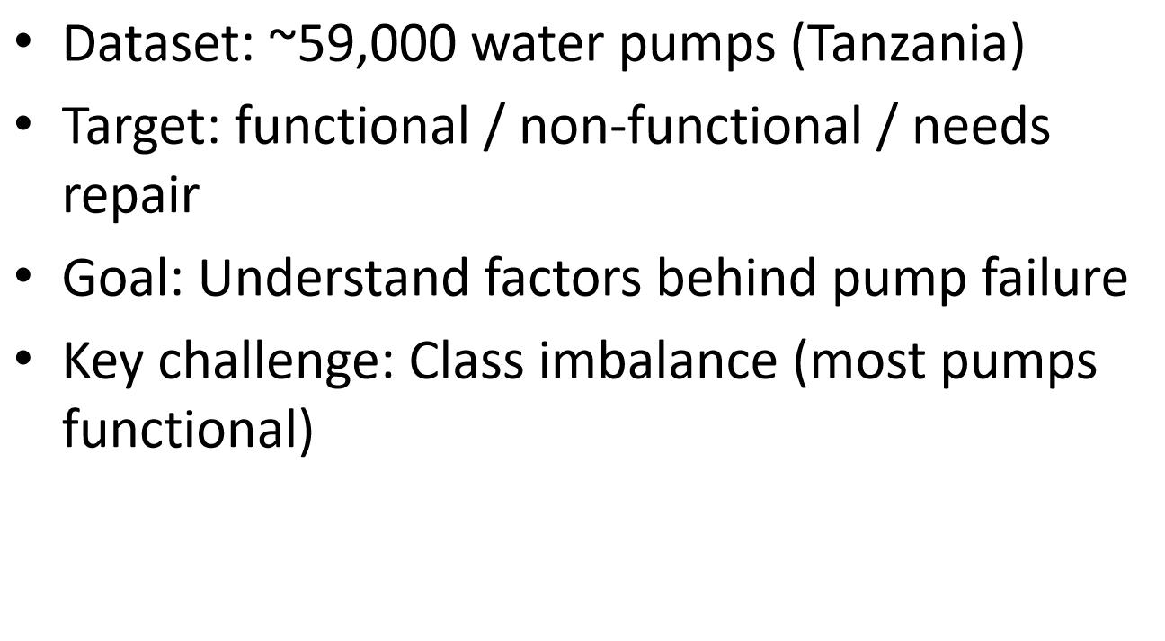

Slide 3

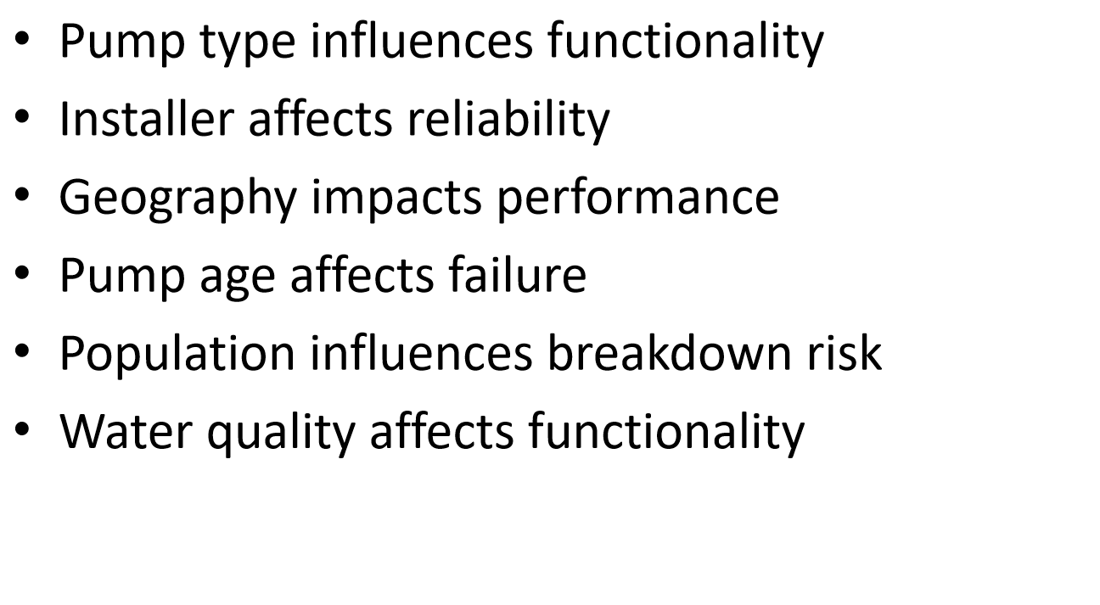

Slide 4

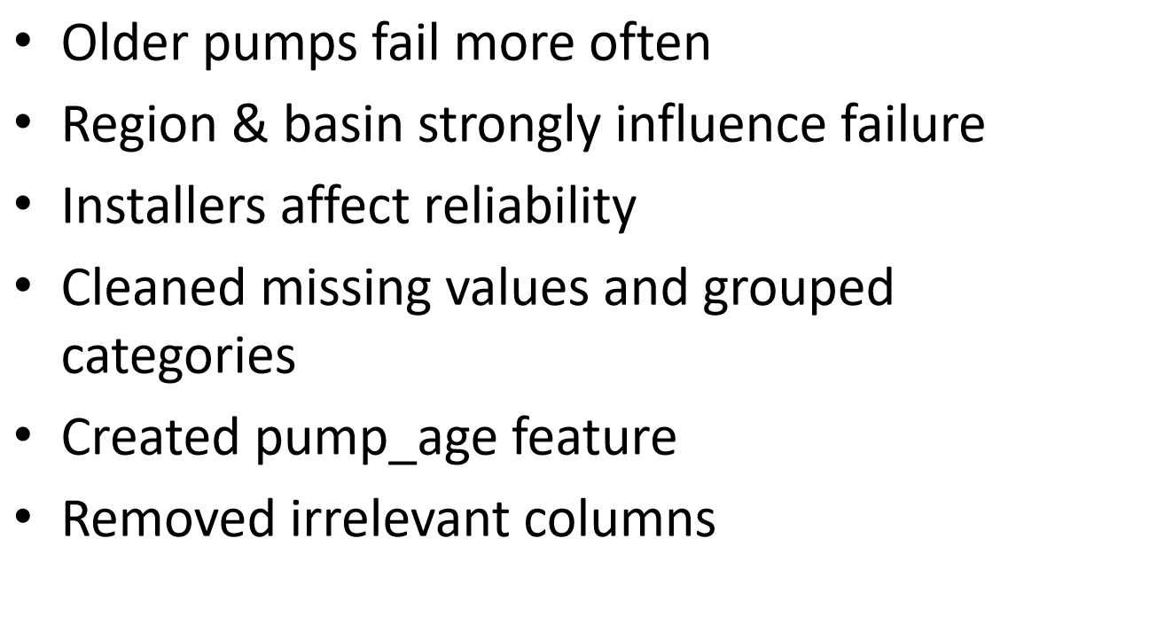

Slide 5
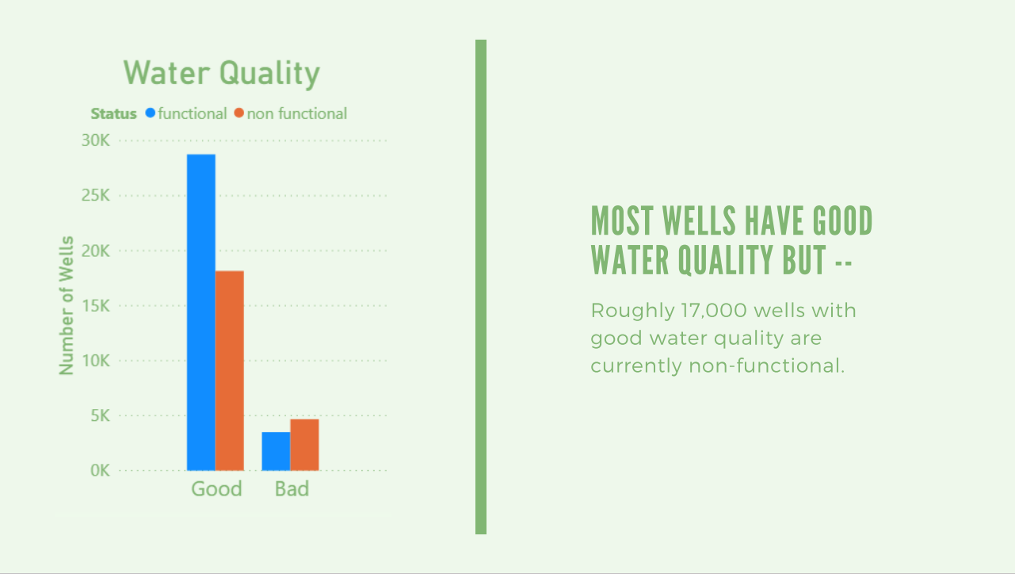

Slide 6
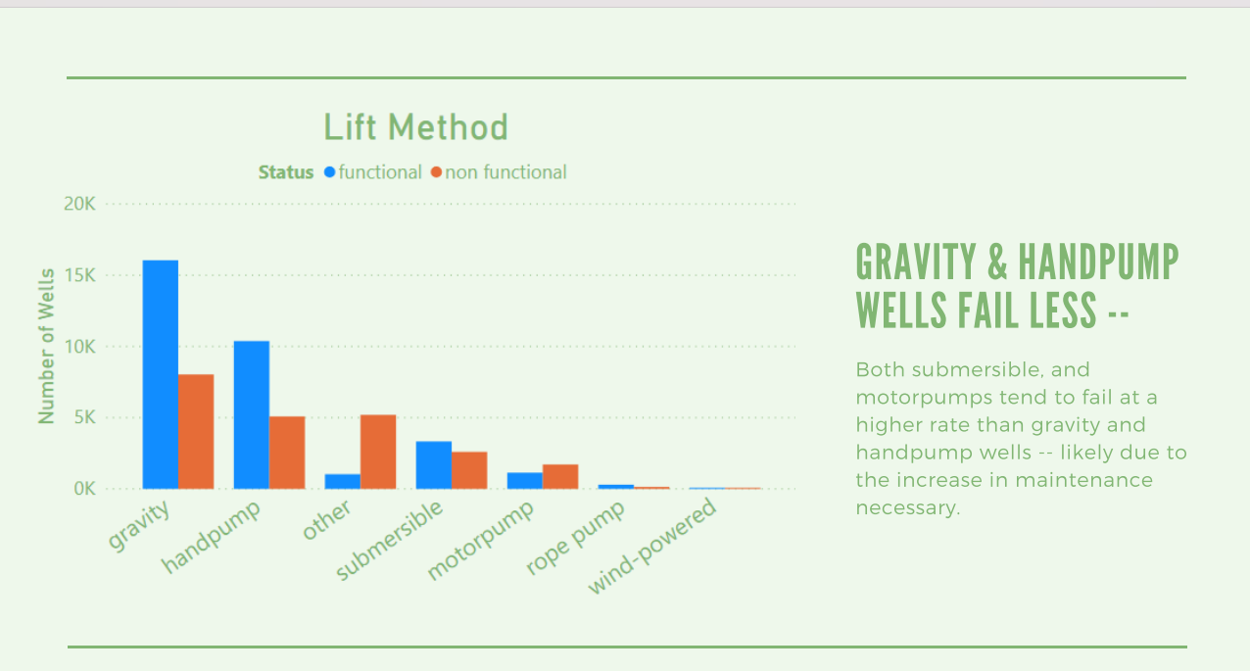

Slide 7
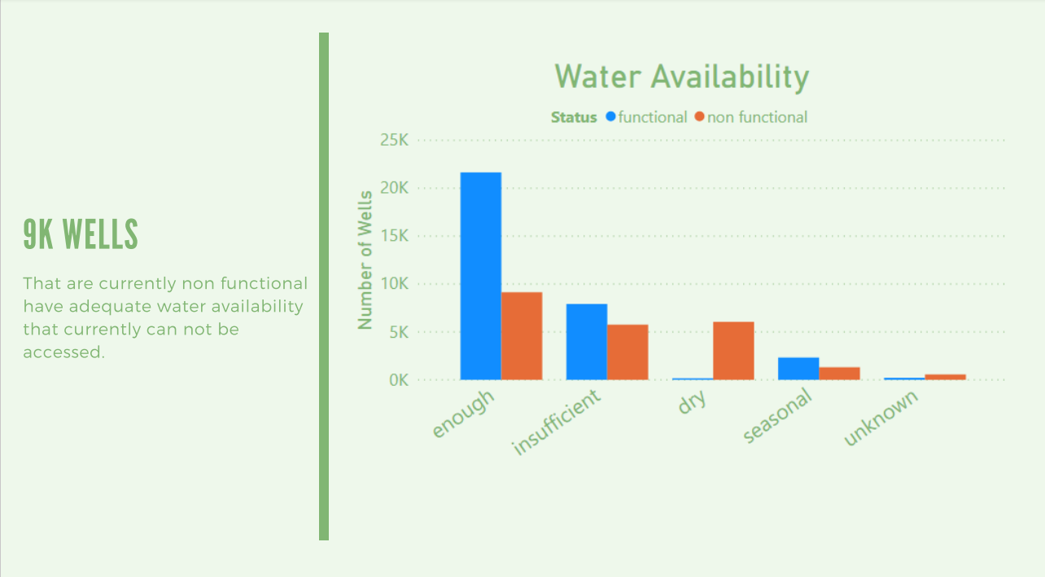

Slide 8

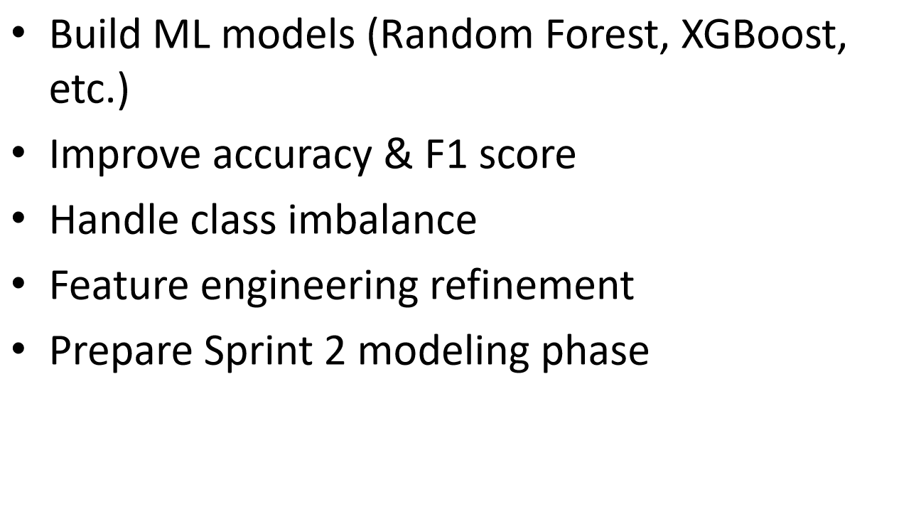

Slide 9

A big Thank You to all TEACHERS of Data Circle , and the entire ReDI family!

